Slide 1
What is a computer.
A Computer is an electronic device that can accept ,process, store , and output information .this information can be anything from text and number and videos.
Understanding hardware :-the physical components:-
Central Prosing Unit (CPU) :- The brain of the computer .
Responsible for performing calculations and instructions .
Memory (RAM) :- Temporary storage for data the CPU is actively using ,allowing for fast access .
Storage Devices :- permanent storage for date ,such as hard drives ,solid –state drives and flash drives .

Slide 2
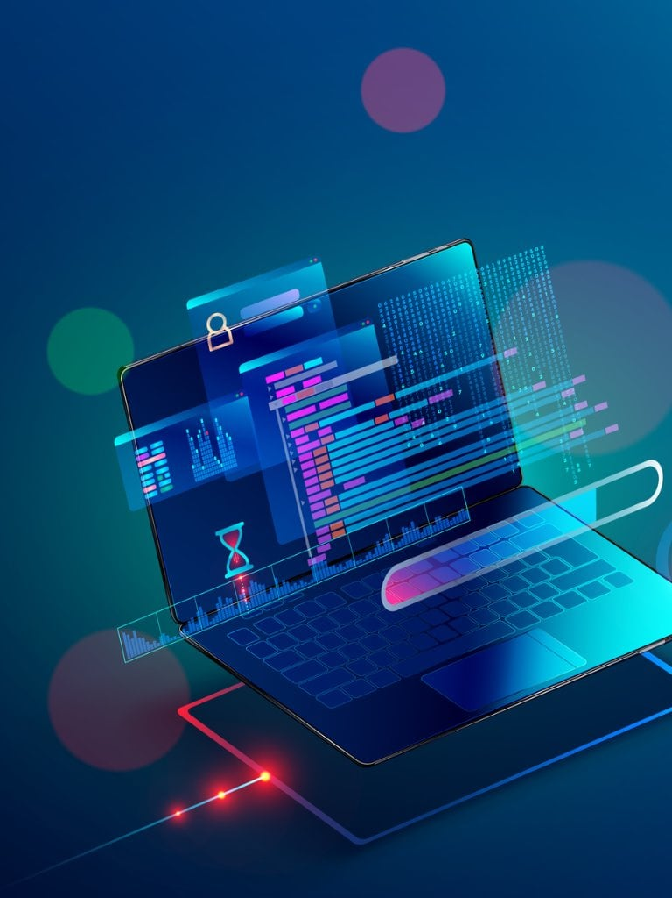
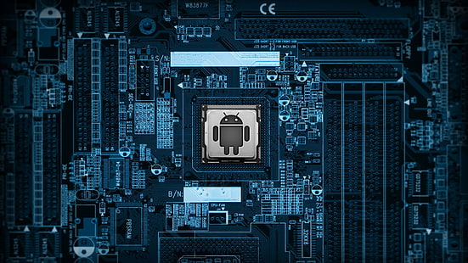
Computer and hardware points.
1)
2)
This Photo by Unknown Author is licensed under CC BY-SA-NC

Slide 3
Exploring Software :- The instructions and Programs .
Operating System (OS) :- The foundation of a computer managing resources and providing a user interface .
Applications :- programs designed to perform specific tasks ,like word processing ,wed browsing , gaming .
Drivers :- Software that enable the OS to communicate with hardware components .

Slide 4
Input Devices :- Communicating with the Computer.
Keyboard – Used to enter text ,number ,and commands.
Mouse – Used to control the cursor on the screen ,interact with objects ,and navigate menus .
Touchscreen – Allows for direct interaction with the computer using touch gestures .

Slide 5

Output Devices: Receiving Information from the Computer
Monitor Displays visual output, including text, images, and videos. Speakers Produce audio output, such as music, sound effects, and voice. Printer Creates physical copies of documents and images.

Slide 6
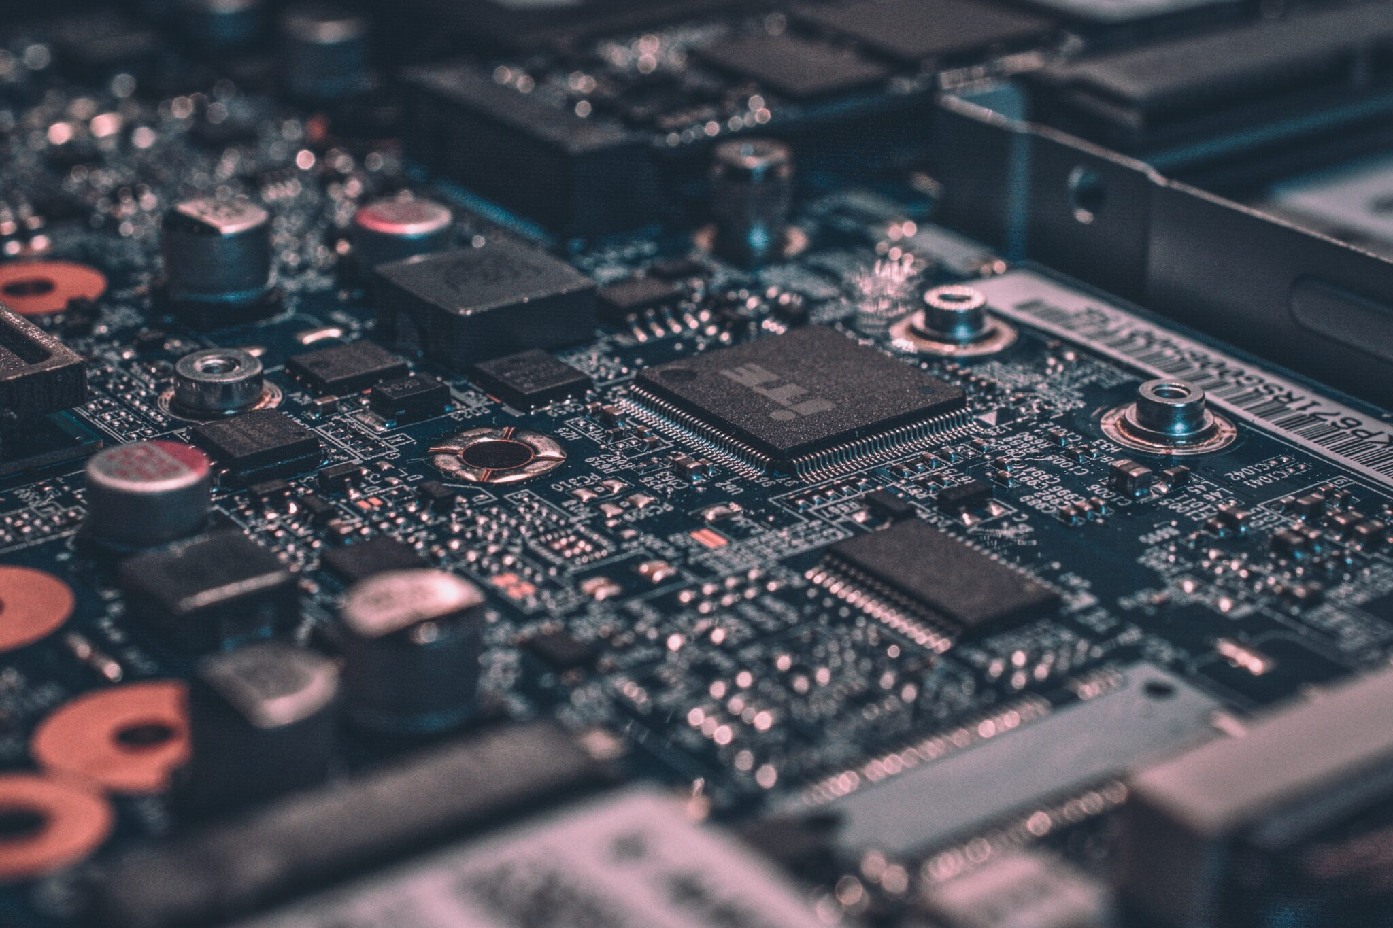
The Relationship Between Hardware and Software
Hardware Provides the physical components and infrastructure. Software Provides the instructions and programs that tell the hardware what to do. Interaction Software relies on hardware to function, and hardware is controlled by software.
This Photo by Unknown Author is licensed under CC BY

Slide 7
Putting it Together: A Simple Computer System
Input Information is entered through input devices like the keyboard and mouse
Processing The CPU interprets and executes instructions from software, manipulating data
Output Processed information is displayed through output devices like the monitor and speakers.
Storage Data is stored permanently on storage devices for future use.

Slide 8

Quiz: Test Your Knowledge
What is the main function of the CPU? To process information and execute instructions. What is the difference between RAM and storage? RAM is temporary storage for active data, while storage is permanent storage. Name two input devices and two output devices. Input: keyboard, mouse; Output: monitor, speakers.

